Slide 1


My work
for BRANE
No Code Platform

Slide 2
Product Overview
- Building Solutions/Applications in Natural Languages without writing or generating a Single Line of Code.
- The platform enables the development of enterprise-level applications (ERP, CRM, SCM, Health Care etc.) using a natural solution language.
- Empowers SMEs, Students and Business owners without coding, UI, or UX expertise to create and deliver solutions.
- Reduces development time by more than 90% compared to traditional methods.
- Tailored to meet the needs of businesses across all industries.

Slide 3
Challenges
- Mapping Data Types to the Natural Language.
- Aligning Database Structures to the Natural Language.
- Identification of UI controls using Natural Language.
- Creating Logic for the Application with basic queries.
- Dynamic process to to Auto Generate UI/UX with Natural Language.

Slide 4
Target Audience
- SME`s and BA`s across industries.
- Students with basic computer skills.
- Audience having basic academic qualification in any discipline.

Slide 5
User Research Details
Resources
Methods
10th Class Students
from (CBSE and State Board)
Globally diverse Subject Matter Experts
In Person User Interviews
Survey Forms
Over the Video Interviews
Engineering Students
from multiple Branches
(CSE, Mechanical, ECE)
Business Analysts across domains.
Analytics Objectives
Learning Curve Time
Task Completion Rate
Happy flow index

Slide 6






Benchmark

Slide 7
Design Systems | Runtime
- Developed an automated design system with dynamic runtime generation.
- Enabled granular level customizations on top of default generated Applications.
- Facilitated instant UI/UX changes on the platform for Applications.
- Supported comprehensive component-level responsiveness and instant changes.
- Ensured device-friendly compatibility across various devices.

Slide 8




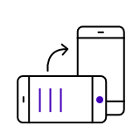
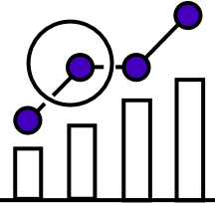
Runtime
Customization Areas
Form
Table
Card
Accordion
Vertical Table
Widgets
Data types / UI Controls
Customization Options for Entity View Styles to Suit Different Business Needs
‹#›

Slide 9
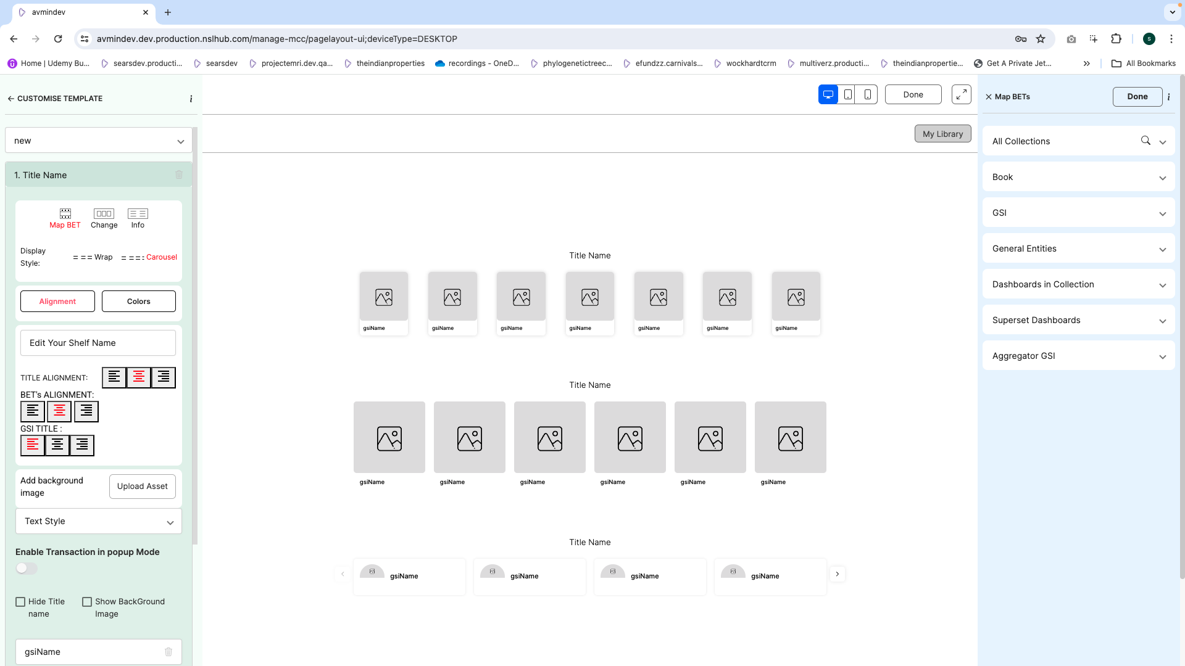
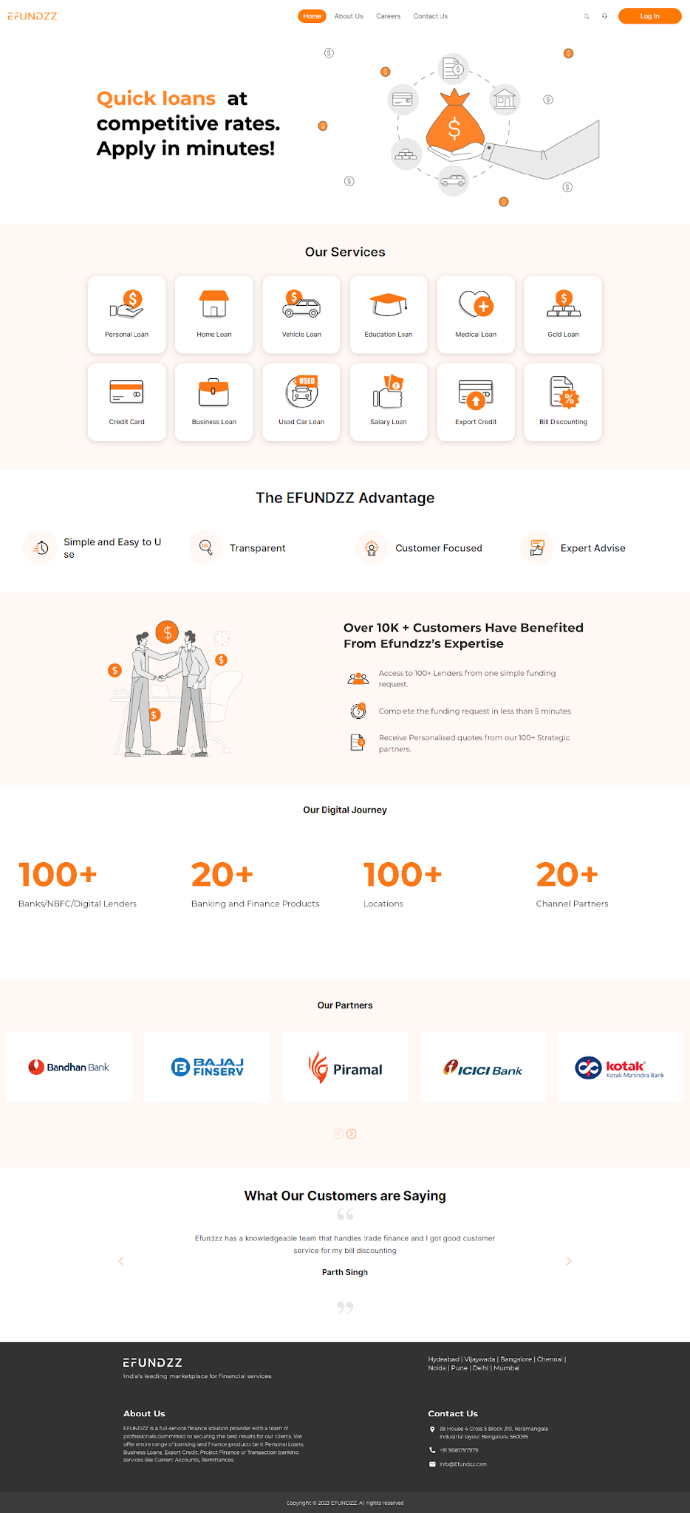
Dynamic Builder
‹#›

Slide 10
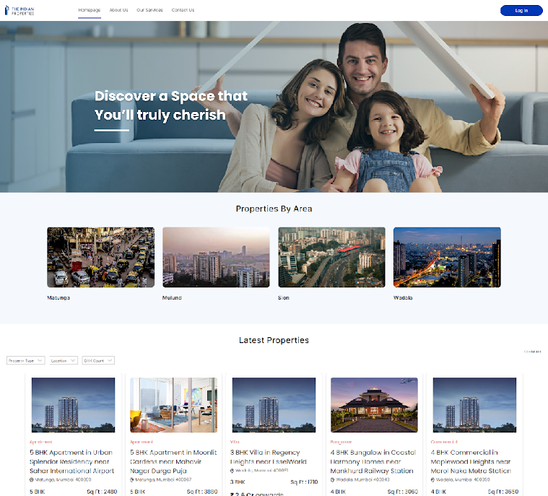
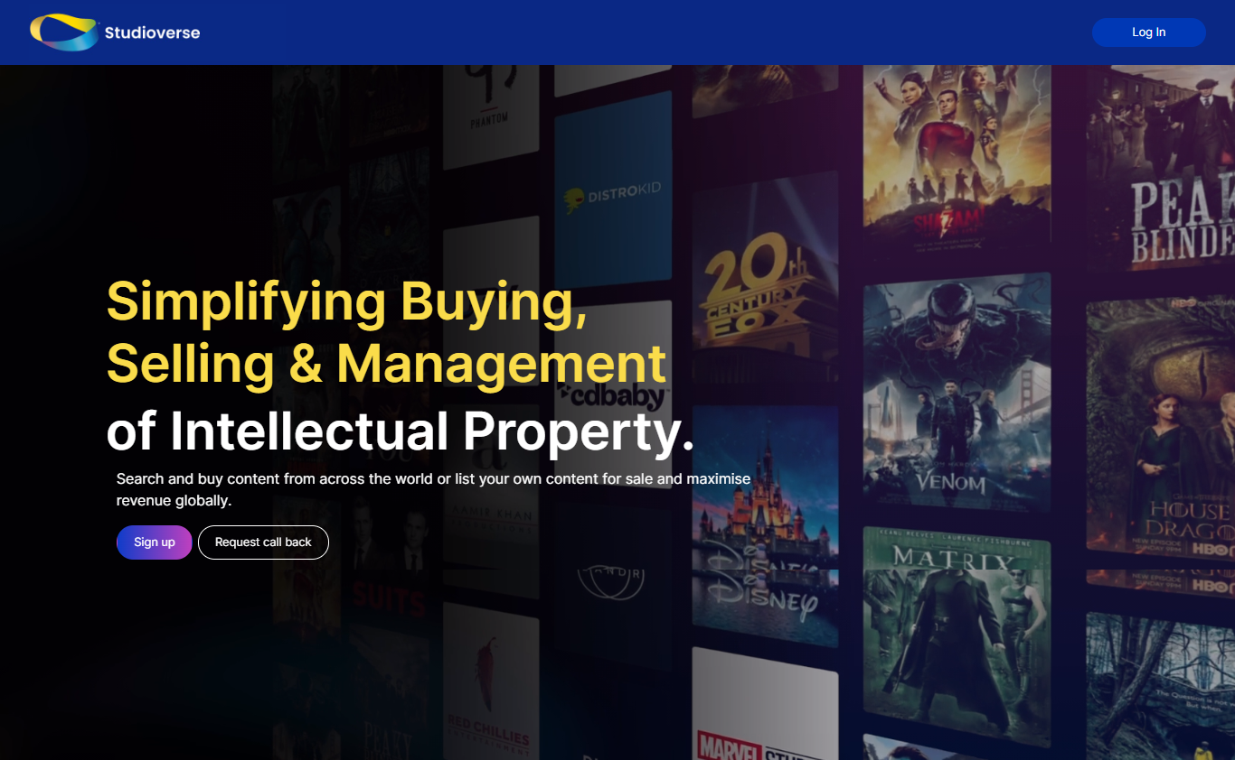
Output
Landing Pages
Custom Landing Screens to Suit Business Requirements. DIV Approach for both Dynamic and Static Page Creation.
‹#›

Slide 11
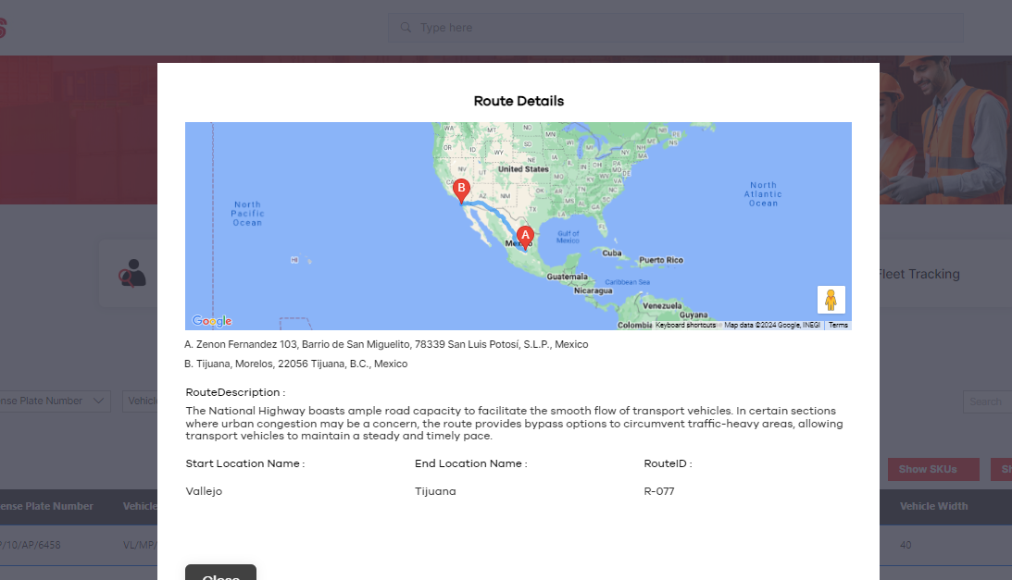
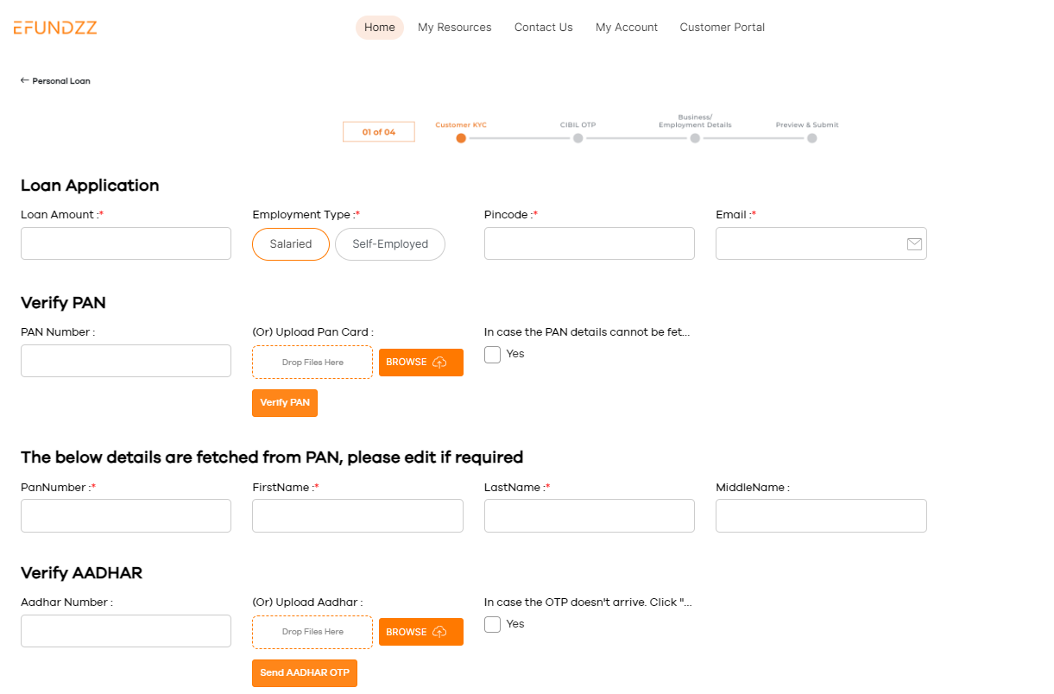
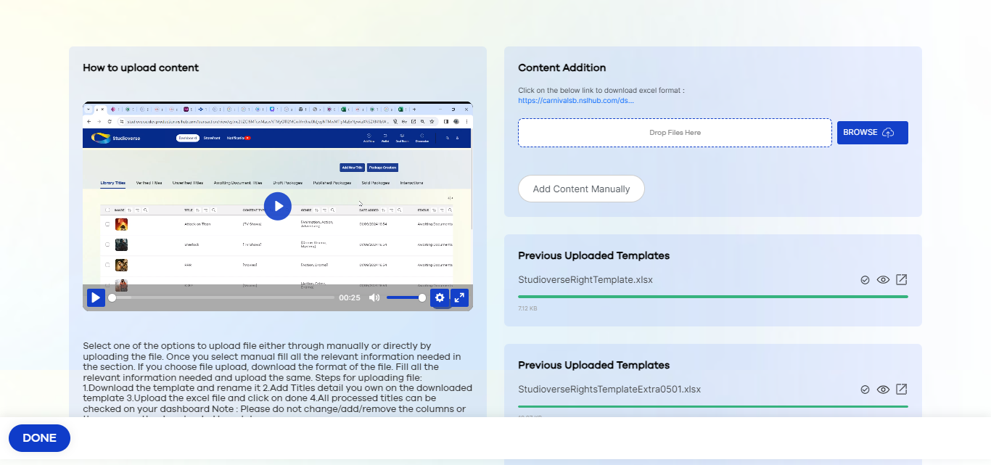
Customization Areas
Customizing Solutions to Suit Client Requirement
Transaction Screens
Custom Transaction Screens for Different Solution Designs. Templatized approach for cleaner and faster implementation
‹#›

Slide 12
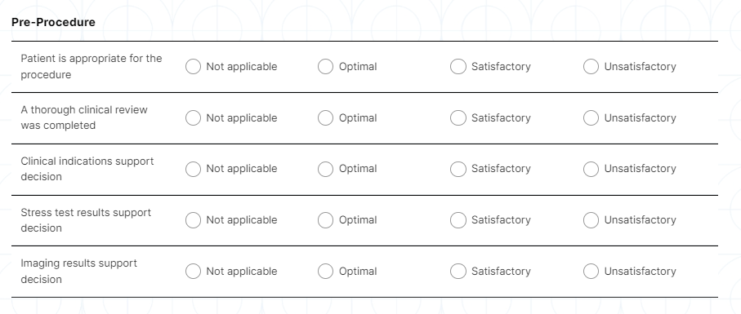
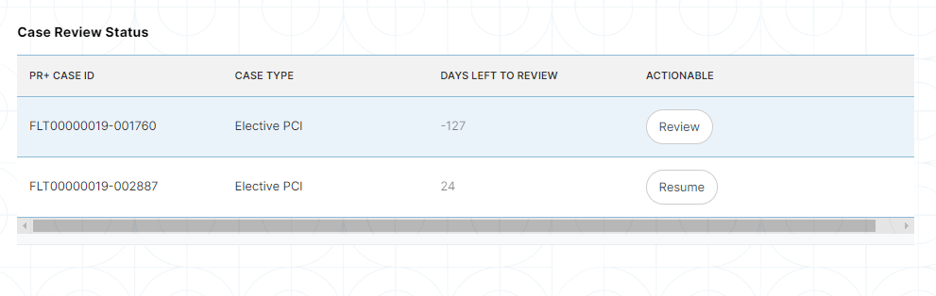
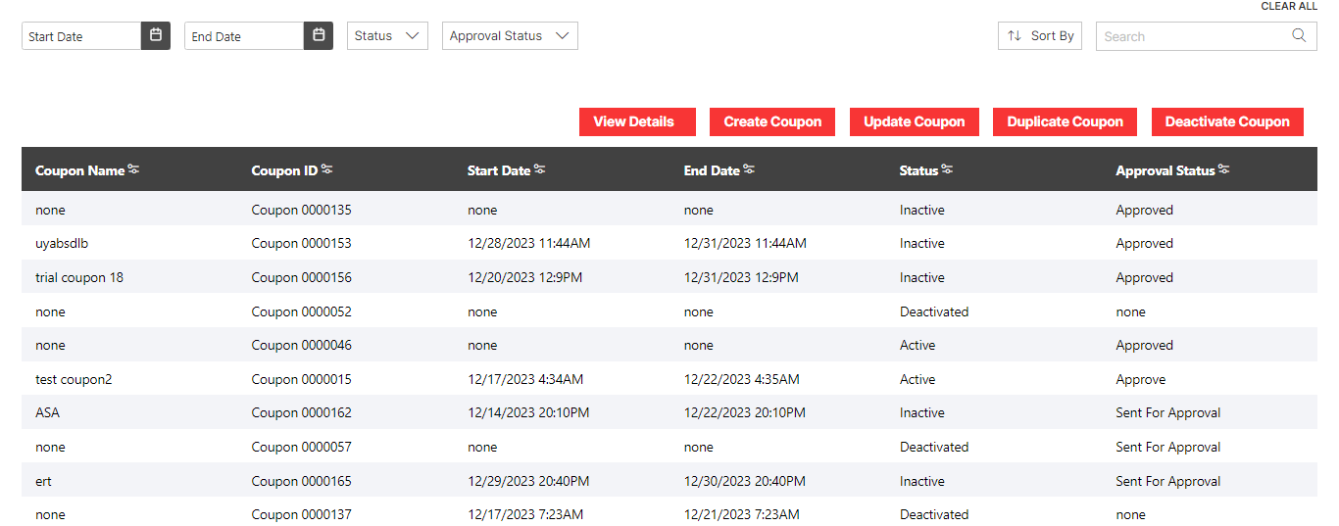
Customization Areas
Customizing Solutions to Suit Client Requirement
Data Types / UI Controls
Customization Options for Entity View Styles to Suit Different Business Needs
‹#›

Slide 13
Following are executed outputs by the design system and No code Platform.

Slide 14
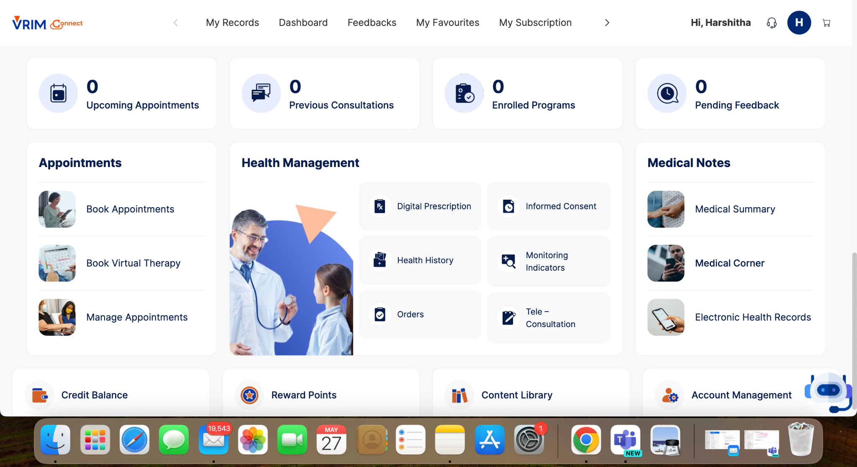

Slide 15
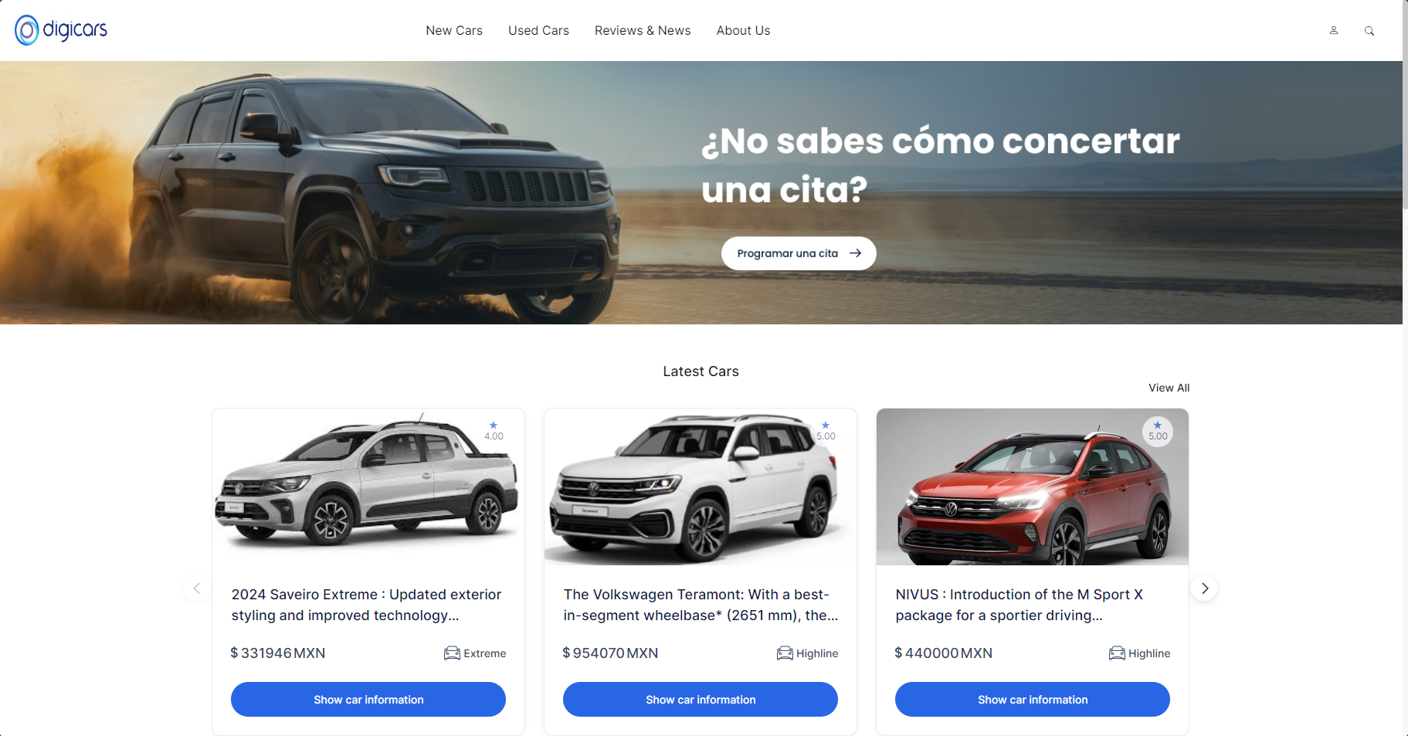

Slide 16
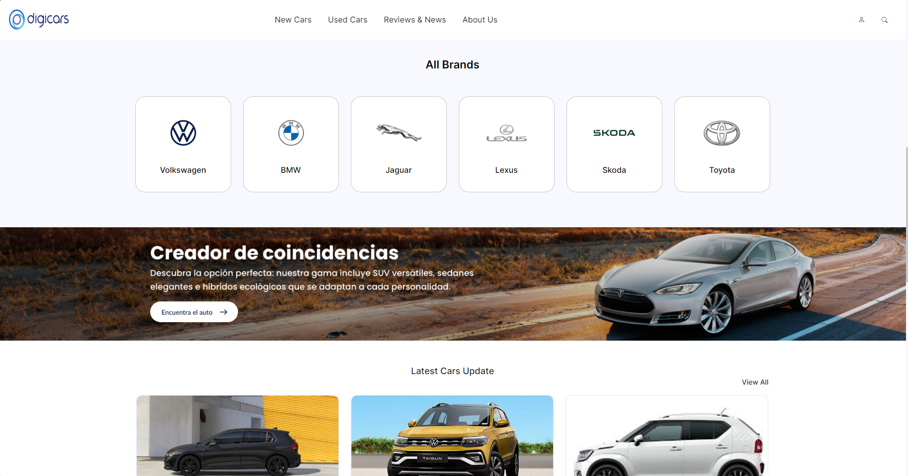

Slide 17
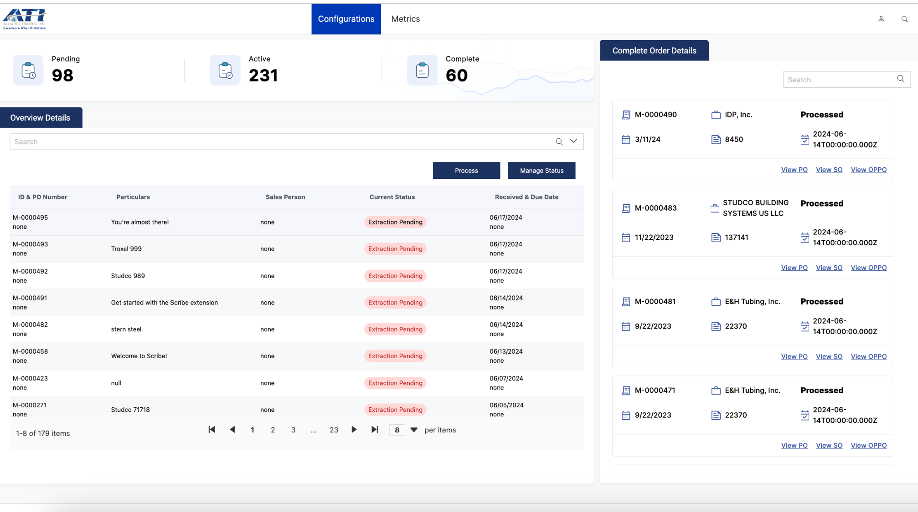

Slide 18
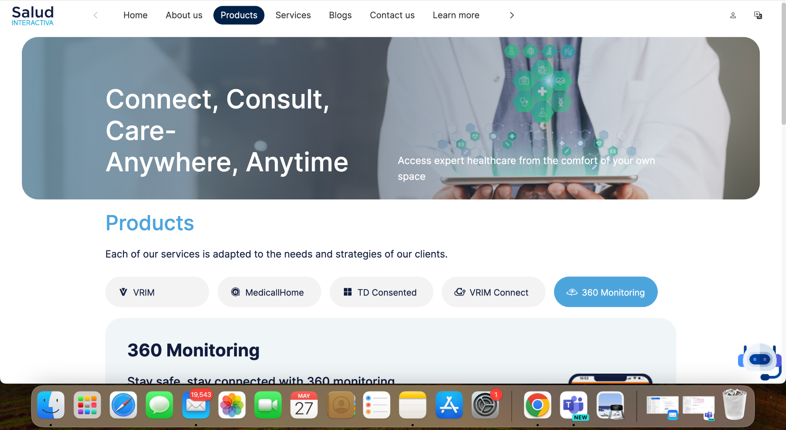

Slide 19
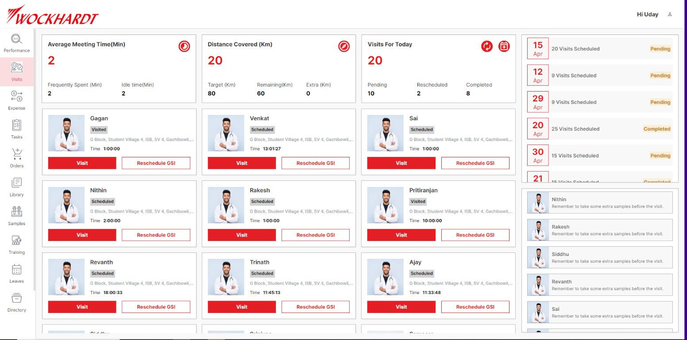

Slide 20
Thank You

